Slide 1
Heap Sort

Slide 2
Binary Tree
Binary tree : A tree in which every node other than the leaves has two children.
Complete Binary tree: A complete binary tree is a binary tree in which every level, except possibly the last, is completely filled.

Slide 3
Height of node: The height of a node is the number of edges on the longest path from the node to a leaf.
Height of tree: It is equal to the height of root node
Depth of node: The depth of a node is the number of edges in the path from root to that node
The height of a tree is equal to the max depth of a tree.

Slide 4
Binary Heap
A heap is a complete binary tree which satisfy heap ordering property (max heap or min heap)
Can be implemented efficiently in an array.
It can be used for heap sort and the efficient representation of certain dynamic priority lists, such the list of tasks to be scheduled by an operating system.

Slide 5
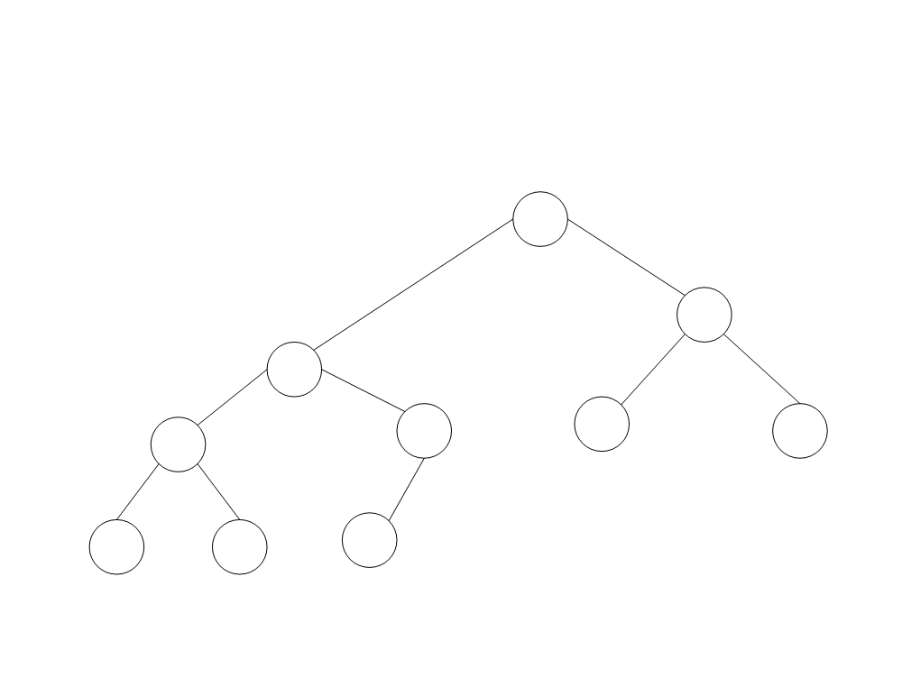
Heap : A complete binary tree
T[1]
T[3]
T[2]
T[4]
T[5]
T[6] T[7]
A complete binary tree containing 10 nodes.
Five internal nodes occupy level3 (the root), level 2, and the left side of level 1.
Five leaves fill the right side of level 1 and then continue at the left of level 0.
T[8] T[9]
T[10]

Slide 6
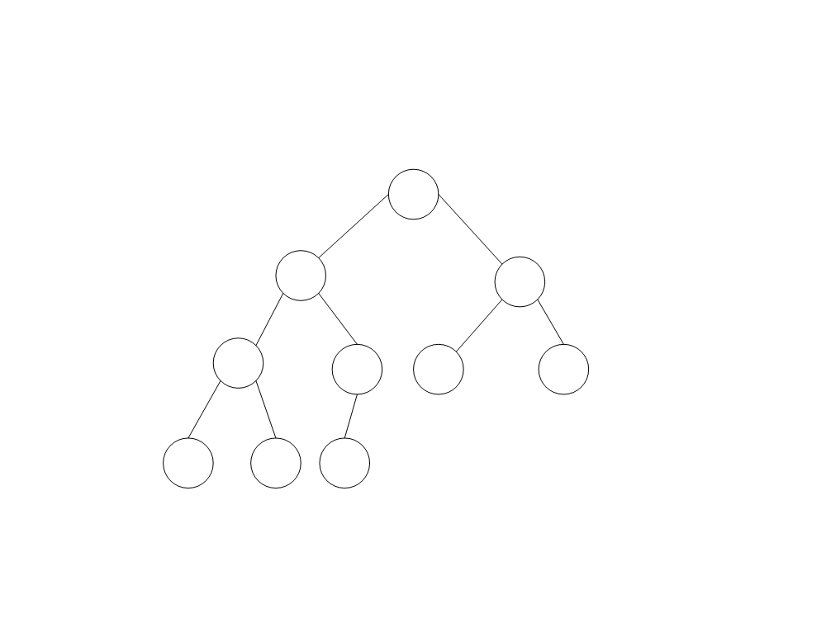
A heap
Now we have marked each node with its value
10
7
9
4
7
5
2
2
1
6
Figure shows an example of a heap with 10 nodes.

Slide 7
Heap
This same heap can be represented by the following array.
The crucial characteristic of this data structure is that the heap property can be restored efficiently if the value of a node is modified.
If the value of a node increases to the extent that it becomes greater than the value of its parent, it should be sufficient to exchange these two values, and then to continue the same process upwards in the tree if necessary until the heap property is restored.

Slide 8
Heap
The modified value is moved up to its new position in the heap
This operation is often called sifting up

Slide 9
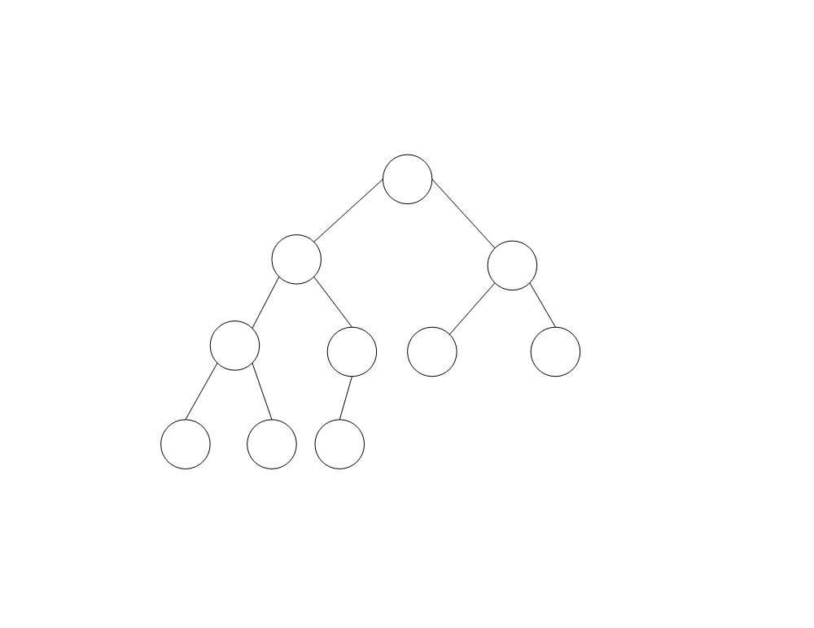
Replace 1 with 8:
The heap, after moving 8 to its place
10
8
9
7
7
5
2
2
4
6
If the value “1” in Figure is modified so that it becomes “8”, we can restore the heap property by exchanging the 8 with its parent “4” and then exchanging it again with its new parent “7”.

Slide 10
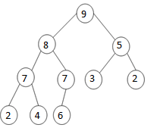
Heap
If on the contrary the value of a node is decreased so that it becomes less than the value of at least one of its children, it suffices to exchange the modified value with the larger of the values in the children, and then to continue this process downwards in the tree if necessary until the heap property is restored.
The heap, after sifting 3 (originally 10) down to its place
The modified value has been sifted down
to its new position.

Slide 11
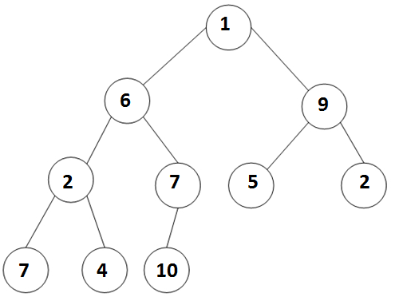
Making Heaps
There exists a clever algorithm for making a heap. Suppose, for example, that our starting point is the following array represented by the tree in Figure.
1 | 6 | 9 | 2 | 7 | 5 | 2 | 7 | 4 | 10
The starting situation

Slide 12
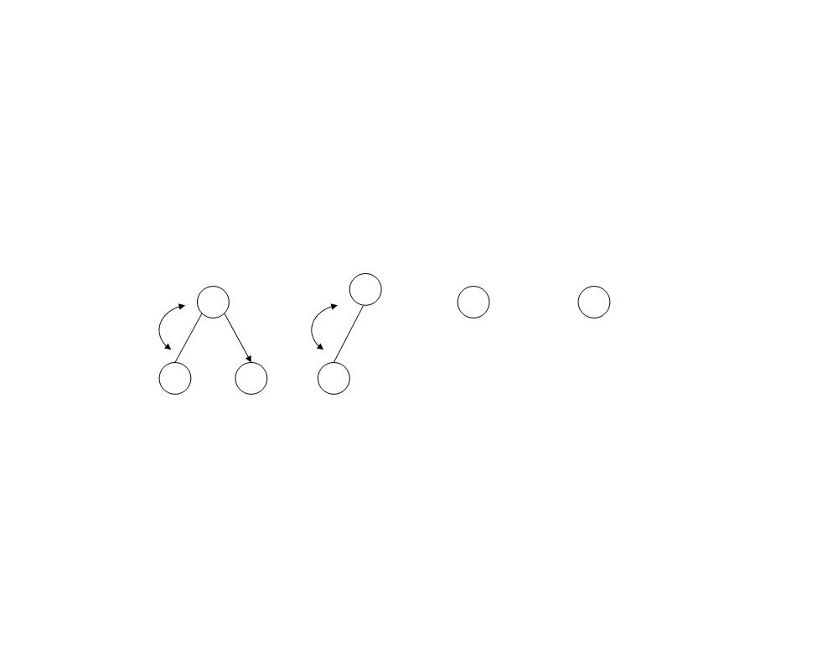
Heaps
We first make each of the subtrees whose roots are at level 1 into a heap, this is done by sifting down these nodes, as illustrated in Figure.
7
10
5 2
2 4 7
The level 1 subtrees are made into heaps

Slide 13
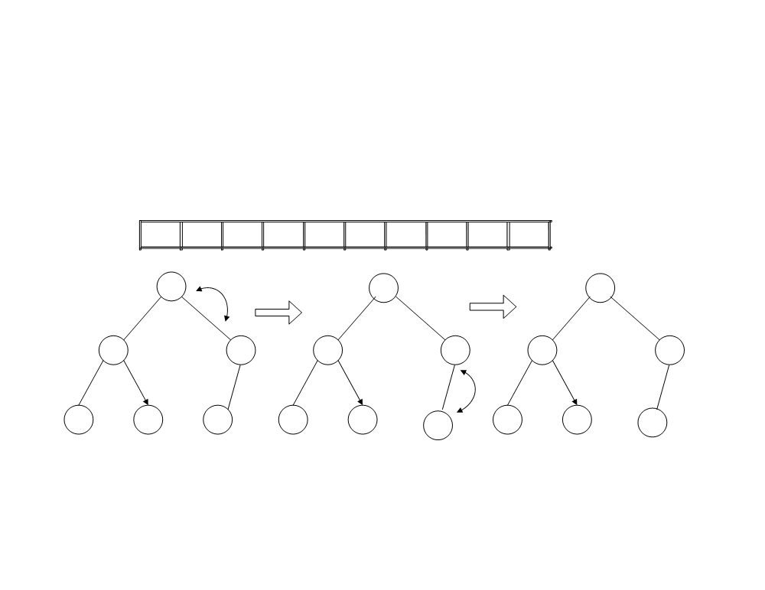
Heaps
This figure shows the process for the left subtree. The other subtree at level 2 is already a heap. This results in an essentially complete binary tree corresponding to the array.
1
10
9
7
7
5
2
2
4
6
6
10
10
7
10
7
6
7
7
2
4
7
2
4
7
2
4
6
One level 2 subtree is made into a heap (the other already is a heap)

Slide 14
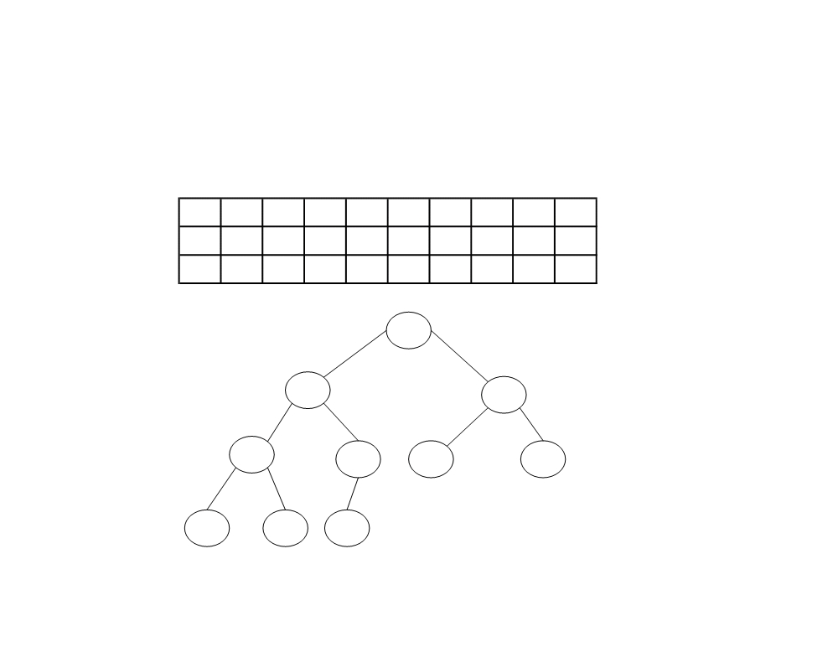
It only remains to sift down its root to obtain the desired heap. This process thus goes as follows:
10
1
9
7
7
5
2
2
4
6
10
7
9
1
7
5
2
2
4
6
10
7
9
4
7
5
2
2
1
6
10
7
9
4
7
5
2
2
1
6

Slide 15
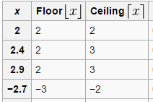
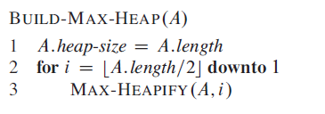
Build Heap

Slide 16
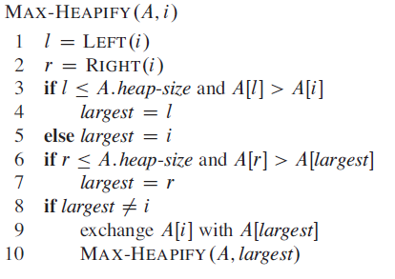
Max Heapify
// l = 2i
// r = 2i+1

Slide 17
Task
A=(16, 4, 10, 14, 7, 9, 3, 2, 8, 1)

Slide 18
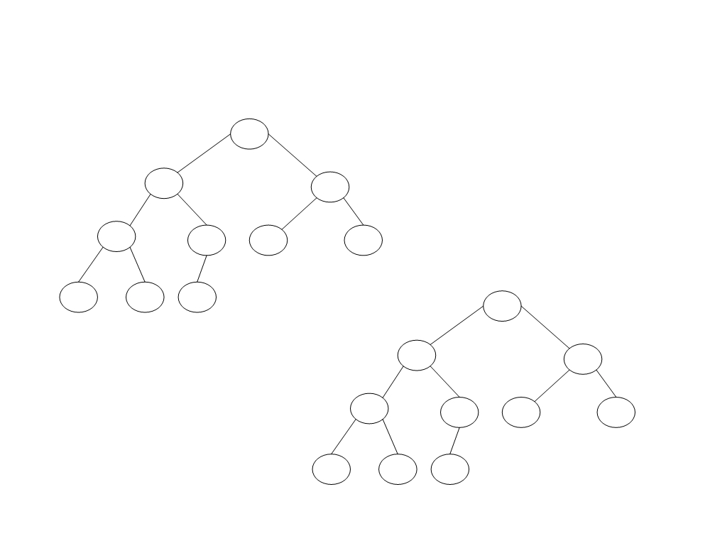
Build Heap
Construct the heap using the array A=(16, 4, 10, 14, 7, 9, 3, 2, 8, 1)
16
4 10
The initial configuration
14 7 9 3
2 8 1
16
14 10
8
7 9 3
Maintaining heap property
2
4 1

Slide 19

Worst case analysis of heap sort
Build heap (A) :
Time taken by max-heapify for nodes at lowest height is 0
Time taken by max-heapify for one node at height 1 is O(1)
How many nodes at height h of complete binary tree? ( n / 2^{h+1} )
Time taken by max-heapify for all node at h level is

Slide 20
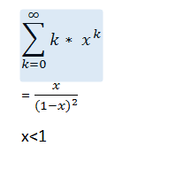





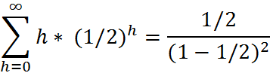

=

Slide 21
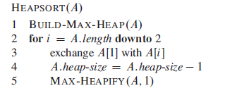
Heap sort

Slide 22
Heap sort
Ascending order
Build Max heap tree
In a max heap, the keys of parent nodes are always greater than or equal to those of the children and the highest key is in the root node.
Descending order
Build Min heap tree
In a min heap, the keys of parent nodes are less than or equal to those of the children and the lowest key is in the root node.

Slide 23
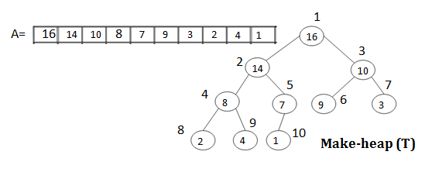
How to sort heap

Slide 24
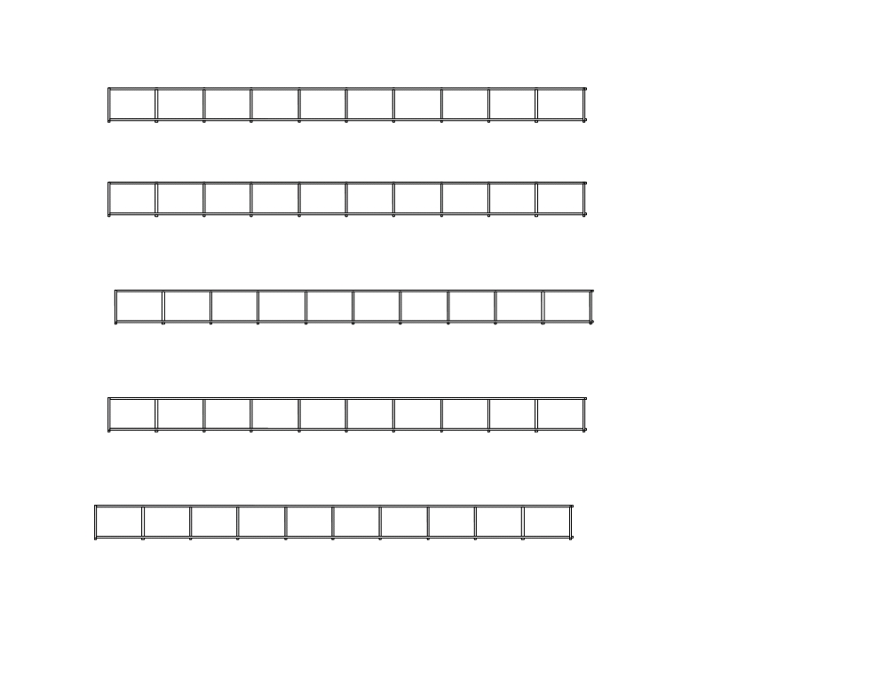
i = 10, exchange T[1] & T[10] and Max-heapify (T[1..9],1)
14
8
10
4
7
9
3
2
1
16
1
2
3
4
5
6
7
8
9
10
i = 9, exchange T[1] & T[9] and Max-heapify (T[1..8],1)
10
8
9
4
7
1
3
2
14
16
1
2
3
4
5
6
7
8
9
10
i = 8, exchange T[1] & T[8] and Max-heapify (T[1..7],1)
9
8
3
4
7
1
2
10
14
16
1
2
3
4
5
6
7
8
9
10
i = 7, exchange T[1] & T[7] and Max-heapify(T[1..6],1)
8
7
3
4
2
1
9
10
14
16
1
2
3
4
5
6
7
8
9
10
i = 6, exchange T[1] & T[6] and Max-heapify (T[1..5],1)
7
4
3
1
2
8
9
10
14
16
1
2
3
4
5
6
7
8
9
10

Slide 25
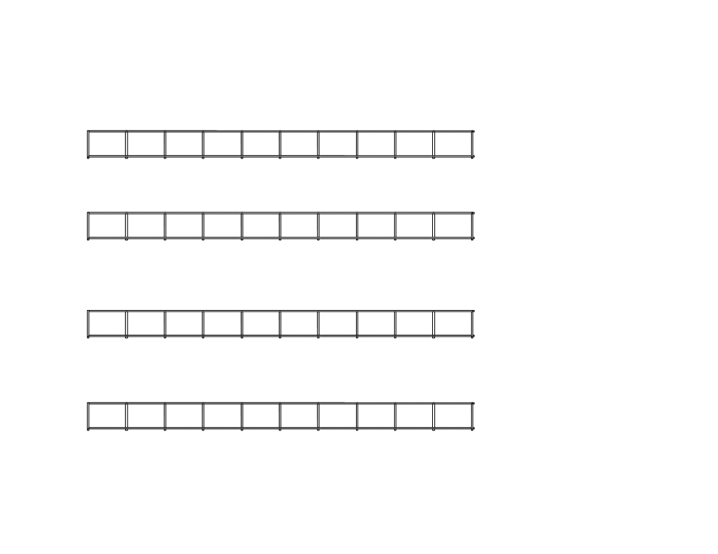
i = 5, exchange T[1] & T[5] and Max-heapify (T[1..4],1)
4
2
3
1
7
8
9
10
14
16
1
2
3
4
5
6
7
8
9
10
i = 4, exchange T[1] & T[4] and Max-heapify (T[1..3],1)
1
2
3
4
7
8
9
10
14
16
1
2
3
4
5
6
7
8
9
10
i = 3, exchange T[1] & T[3] and Max-heapify (T[1..2],1)
2
1
3
4
7
8
9
10
14
16
1
2
3
4
5
6
7
8
9
10
i = 2, exchange T[1] & T[2] and Max-heapify (T[1..1],1)
1
2
3
4
7
8
9
10
14
16
1 2 3 4
5 6 7 8 9 10
End of Sorting

Slide 26
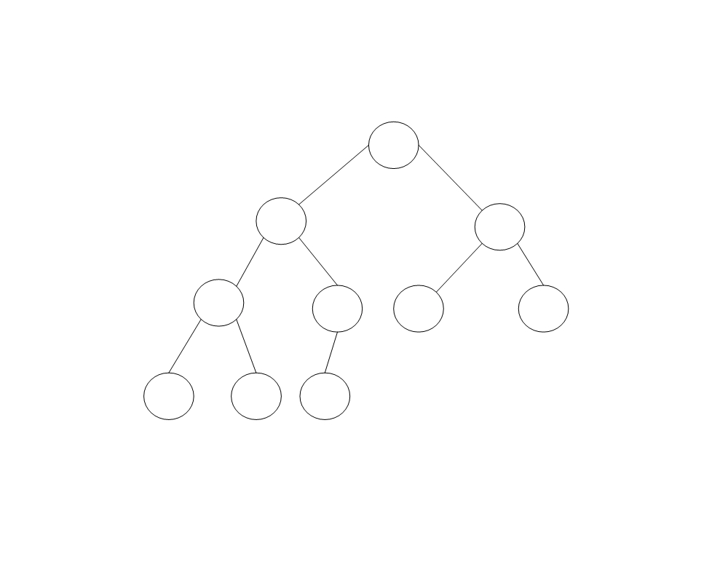
Sorted heap
1
2 3
4
7 8 9
10 14
16

Slide 27
Class Task:
1 | 6 | 9 | 2 | 7 | 5 | 2 | 7 | 4 | 10
Maintain minimum heap tree
Sort heap in descending order

Slide 28
Analysis of heap sort
Max-heapify (A,i) :
n-1 calls to Max-heapify = O(n log n)
(every time root value is shifted down to the leaf)
O(n) + O(n log(n)) = O(n log(n))
all you care about is the dominant term.
n log(n) dominates n so that's the only term that you care about.
Both worst and average case : O(nlogn)

Slide 29
Heap sort (Analysis) extra
log 1 + log 2 + log 3 + · · · + log n
<=log n + log n + log n + · · · + log n
<=n log n
O(n log n)

Slide 30
Task1
Sort the array in descending order using heap sort algorithm
24
21
23
22
36
29
30
34
28
27

Slide 31
Task2
Sort the array in descending order using heap sort algorithm
5
3
1
9
8
2
4
7

